Slide 1

Changes in allele frequencies in gene pools

Slide 2
Syllabus points
Populations are represented as gene pools to reflect the frequency of alleles of a particular gene
Changes in allele frequencies can be caused by:
mutations
selection pressures in natural selection
random genetic drift, including the founder effect
changes in gene flow between adjoining groups
Natural selection enhances survival and reproduction as environment changes
Effects of Genetic diseases on the gene pools:
Tay-Sachs disease
Thalassemia
Sickle-cell anaemia

Slide 3
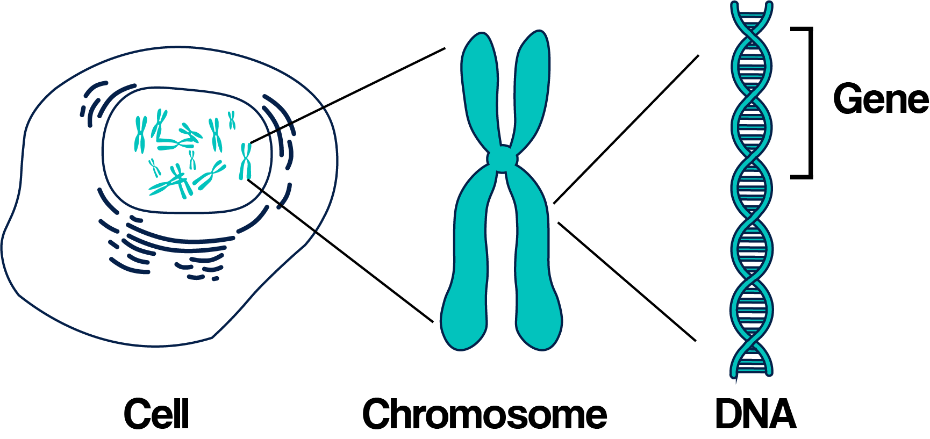
genetics
POPULATION:
Group of the same species living together in a particular place at a particular time
GENES:
Part of a chromosome & a section of the DNA
Factor that determines a hereditary characteristic
However, mutations can alter the expression of a gene

Slide 4
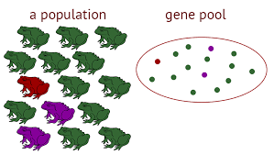
Gene pool
Sum of all alleles carried by the members of a genetic population that are capable of reproducing
It is an array of genes that combine and recombine by sexual reproduction
It indicates the type of genes that are distributed among the population
Described by allele frequencies
Populations differ in the characteristics they posses, such as the Scandinavian gene pool differs from the African gene pool

Slide 5
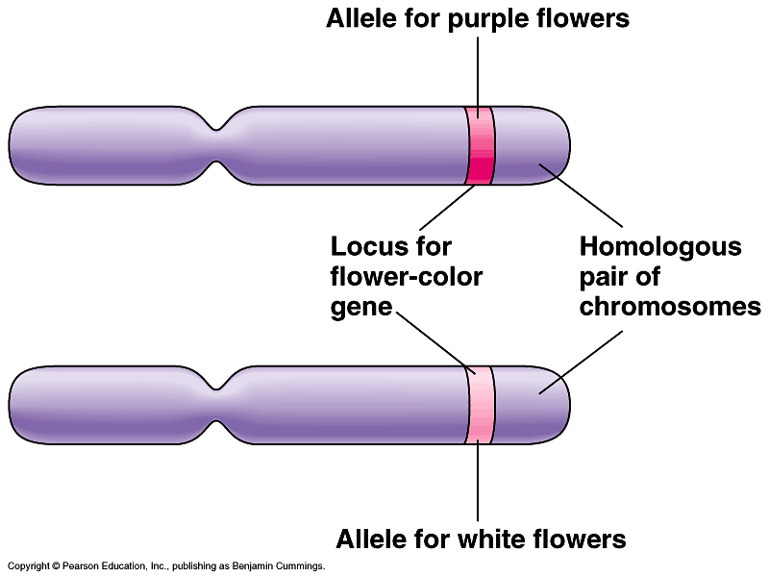
ALLELES
Alternative form of a gene or expression of a gene found in the same place of a chromosome
Each Individual has only two alleles for each gene
Alleles can be:
Dominant allele – characteristic that is expressed (H)
Recessive allele – characteristic that is masked by the dominant allele (h)
Heterozygous – different alleles for given characteristic (Hh) (carrier)
Homozygous – same allele for given characteristic (HH, hh)

Slide 6
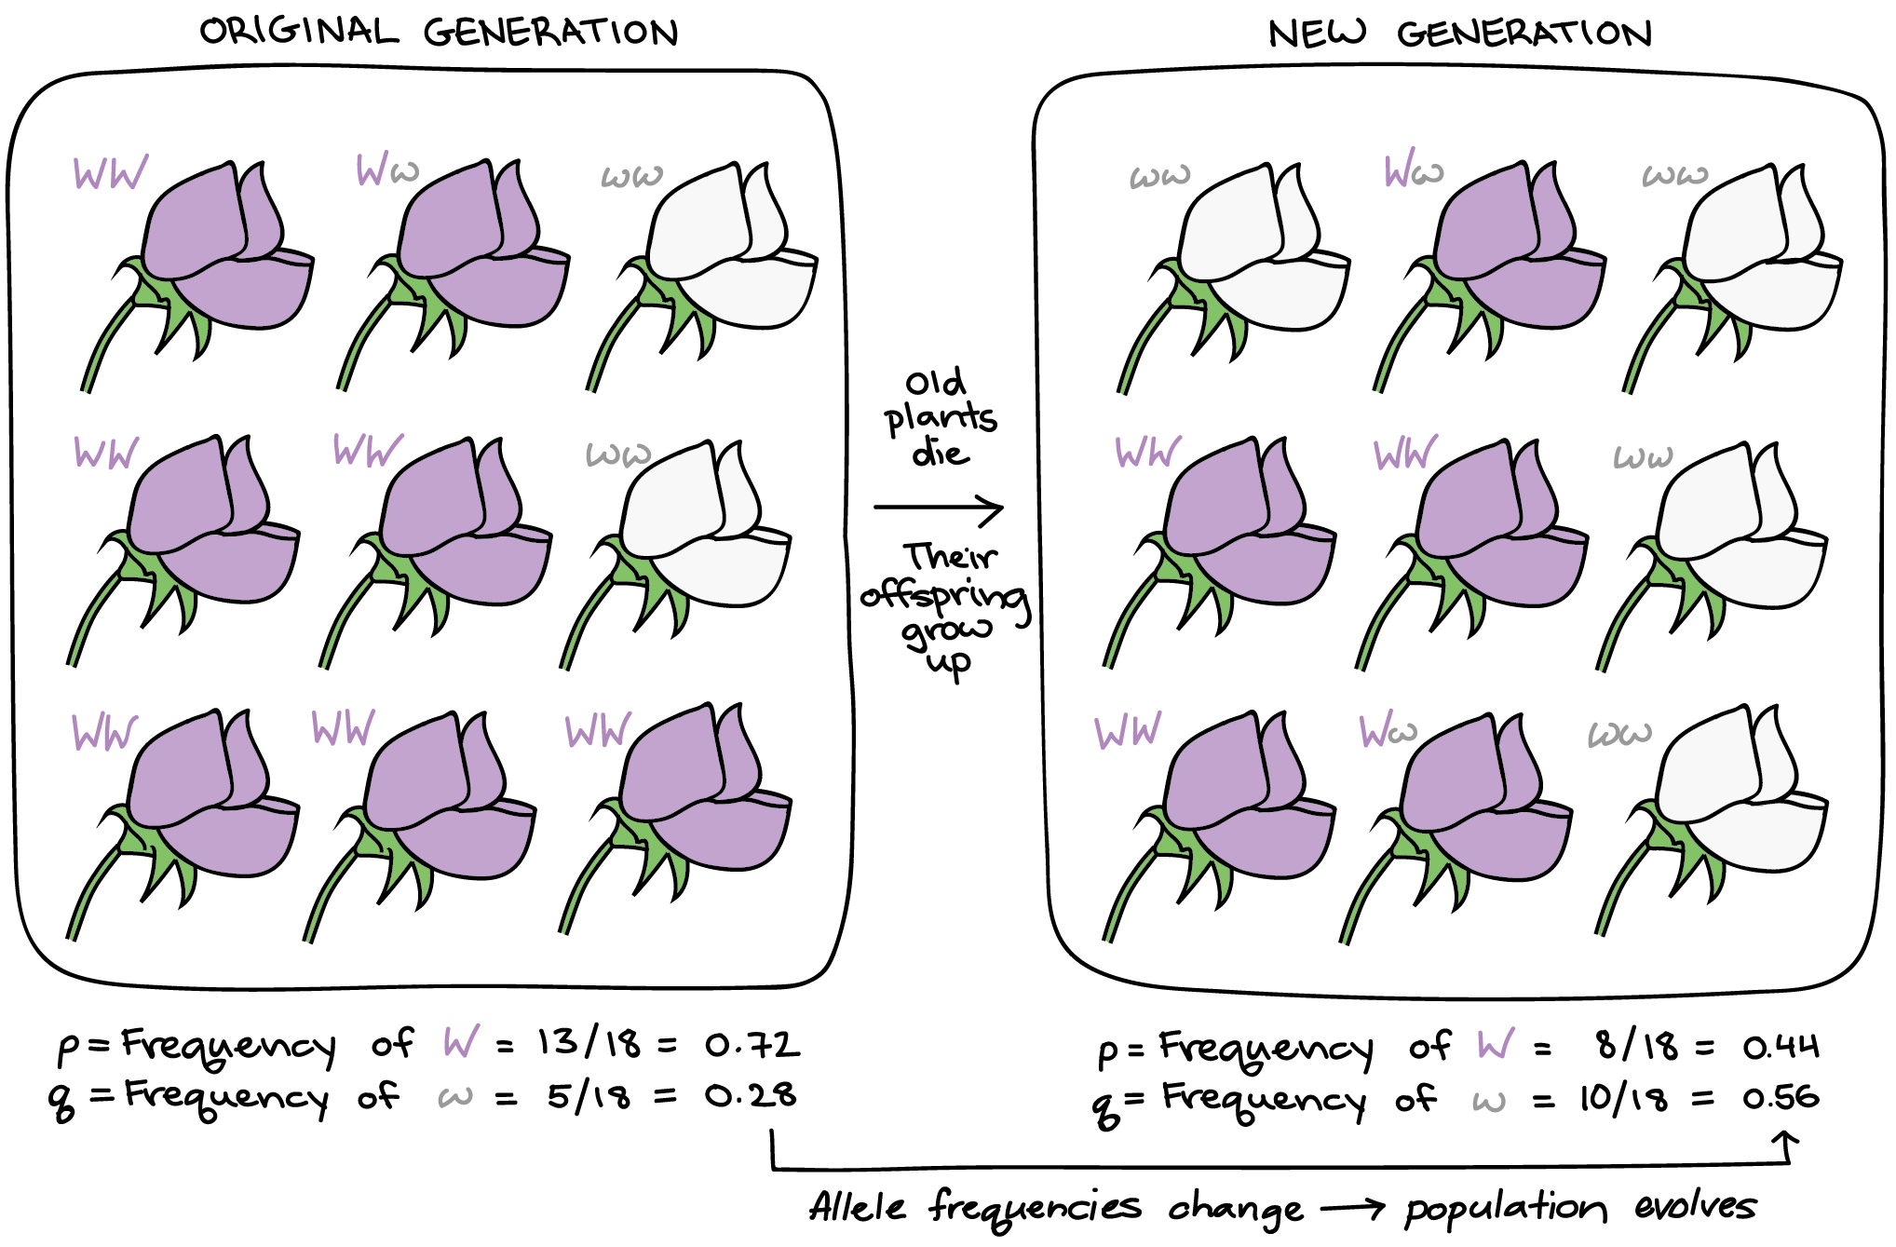
ALLELE frequencies
How often each allele of a gene occurs in a gene pool for a population
By knowing how often characteristics occur in a population, we can work out the frequency of each allele for a particular gene
frequency of each allele for a particular gene, such as brown eyes in an African population is greater than in Scandinavian population (vice versa)
However, changes in the environment results in variations of the allele frequencies
https://www.youtube.com/watch?v=Bc9bhLk_AhI

Slide 7
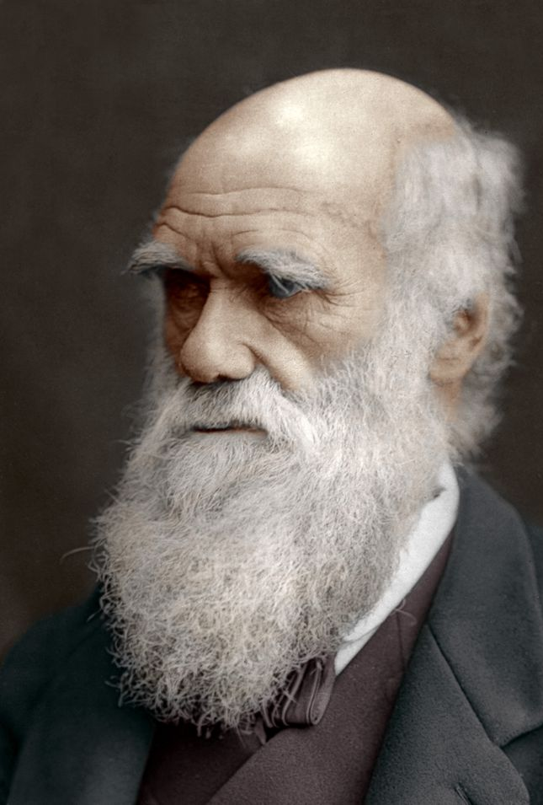
Natural selection
Charles Darwin:
Realized a struggle of existence would occur
Characteristics of organism that best suited the environment are more likely to survive, known as the Survival of the Fittest due to variations in species

Slide 8
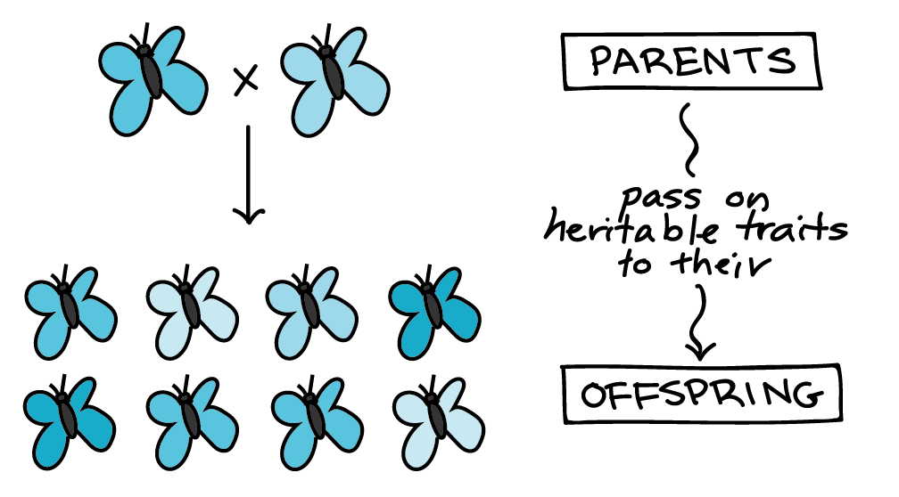
NATURAL SELECTION
Selection of favoring alleles which are passed to enhance survival and reproduction of the species, which allows species to becomes better adapted to the environment.
Nature begins to favor one set of alleles at the expense of others, which results in a major change in allele frequencies in a gene pool called selection pressure
Changing environment favors particular characteristics to enhance survival then frequency for alleles increase overtime as the generations adapt to it
Not random as alleles are not passed randomly to next generation

Slide 9
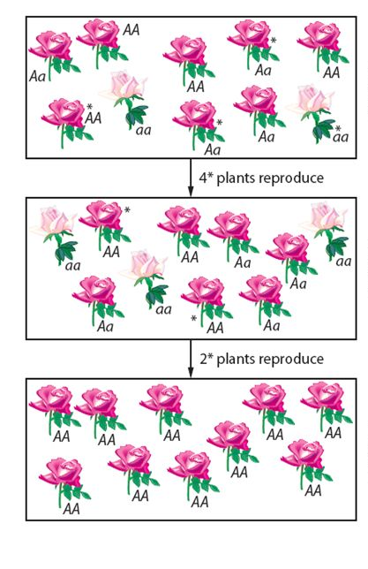
RANDOM GENETIC DRIFT
known as the Sewall Wright Effect
recognizes the random variation changes in allele frequencies, which occurs purely by chance
Occurrence of characteristics in only a small population
certain alleles become more frequent in smaller populations
Example: plant population reproduction
Reproduction of Light pink flowers have decreased by second generation
Light pink is lost from the gene pool by third generation

Slide 10
the founder effect
Similar to genetic drift
Occurs when a small group moves away from its homeland to a totally new area to establish a new community
This new community is a small sample of the original population, but not genetically representative of original population
Examples include isolated groups of islanders, such as Pitcairn Island
https://www.youtube.com/watch?v=-UfrN11V9SM

Slide 11
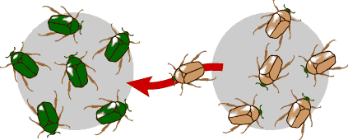
MIGRATION
Results in changes in allele frequencies in a gene pool
Migration is described as a gene flow, which is transfer of alleles from one population to another population through migration
Immigrants to a new country, results in changes in allele frequency for that gene will be altered

Slide 12
Barriers to gene flow
Barriers inhibits the amount of interbreeding between populations
Each population has different environmental pressures, as neither is the same, which results in different characteristics being favored in one populations for survival
Changes in allele frequencies in each gene pool results in populations being less similar as they develop different characteristics better suited for that environment
Isolation contributes to the development of separate gene pools
Types of Barriers include:
Geographical barriers
Sociocultural barriers

Slide 13
Types of barriers
GEOGRAPHICAL
SOCIOCULTURAL
Includes:
Oceans
Mountain ranges
Lakes or deserts
Example:
Indigenous Australian's were isolated for thousands of years due to ocean barriers as the sea levels rose
Includes:
Culture
Language
Different religious groups
Economic status
Educational background
Example:
Individuals are more likely to marry someone with a similar religious group or educational background

Slide 14
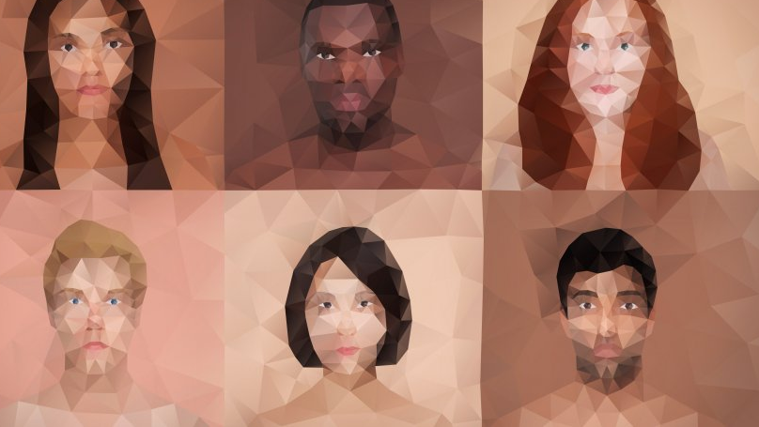
GENETIC VARIATION
A term used to describe the variation in the DNA sequence in each of our genomes.

Slide 15
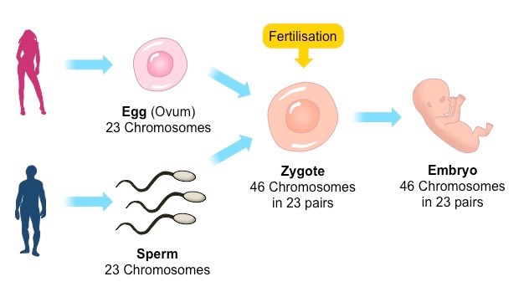
Random fertilization
Each person produces a huge number of sperm or eggs with respect to the alleles each contains
Ability of any one sperm can fertilise any available egg, which results in an infinite number of possible combinations of alleles in the offspring.

Slide 16
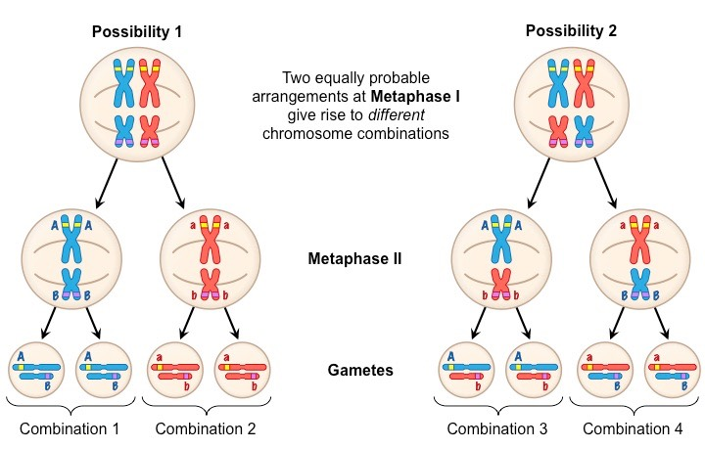
Random assortment
The random separation of maternal and paternal chromosomes
Occurs to chromosomes during the first division of meiosis
Results in gametes to have a huge number of possible combinations of the chromosomes that originally came from the male parent and female parent.

Slide 17
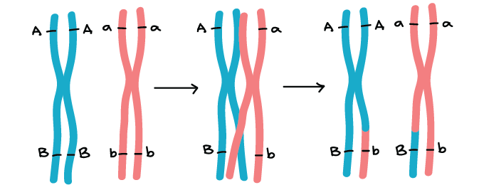
Crossing over
Occurs to chromatids during the first stage of meiosis
The interchange of pieces of a chromatid that is being broken off and attach to a different chromatid.
Results in a changed sequence, or recombination of alleles along the resulting chromosome.

Slide 18
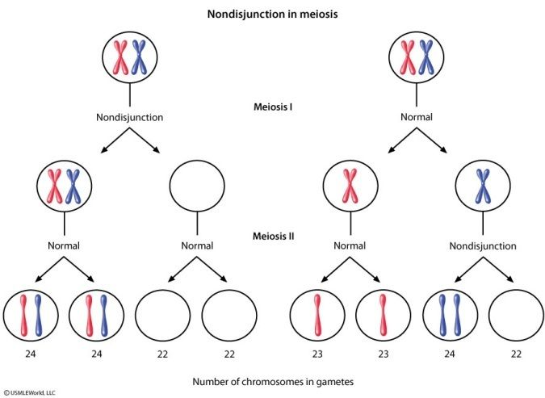
Non-disjunction
Where one or more members of a chromosome pair fail to separate during meiosis.
Results in gametes to have either more or less than the correct number of chromosomes.
This can affect gametes, which results in the embryo to have an incorrect number of chromosomes

Slide 19
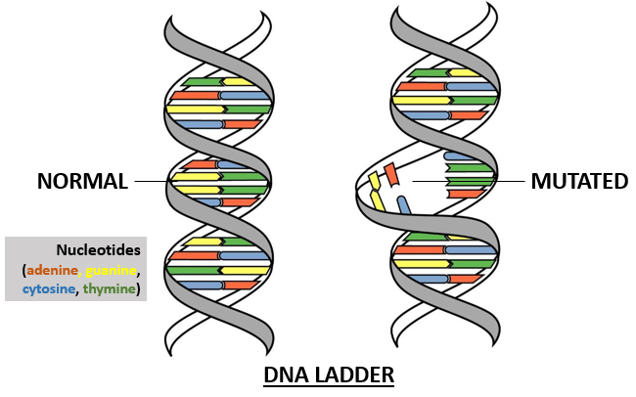
mutations
Are permanent changes in the DNA of a chromosome
May result in a totally new characteristic in an individual.
If the mutation occurs in a gamete, it can be passed on from generation to generation
Consists of two types – Gene mutation and chromosomal mutation
Either affects Somatic and Germline cells

Slide 20
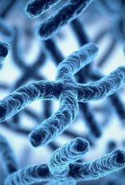
Genetic DISEASES
Results in changes to allele frequencies in a gene pool.
Diseases Include:
Tay-Sachs Disease (TSD)
Thalassaemia
Sickle-Cell Anaemia
Sickle-Cell Trait

Slide 21
TAY-SACHS DISEASE
A hereditary disorder of lipid metabolism.
Cause by a missing enzyme that results in the accumulation of a fatty substance in the nervous system.
Occurs most frequently in individuals of Jewish descent from Eastern Europe (Ashkenazi-Jewish population).
Death usually occurs by the age of four or five.

Slide 22
thalassAemia
An inherited disease caused by a recessive allele, which anaemia results from defects in the formation of haemoglobin.
People with this disease require frequent blood transfusions throughout their life and special drugs to remove the excess irons that tends to build up in the body.
Occurs most frequently in countries along the Mediterranean coast, Italy and Greece descent).

Slide 23
SICKLE-CELL
SICKLE-CELL ANAEMIA:
An inherited disease that results in the blood being a crescent or sickle shape.
Occurs when a person inherits the recessive allele from both parents.
Occurs mainly in black Africans
Sickle-cell shape does not carry as much oxygen as normal red blood cells and they also stick together and block small blood vessels.
SICKLE-CELL TRAIT:
Only one allele for sickle-shaped cells show no ill effect unless oxygen is in short supply, which results in the red blood cells to show mild sickling
https://www.youtube.com/watch?v=hRnrIpUMyZQ

Slide 24
EXAM PRACTICE

Slide 25
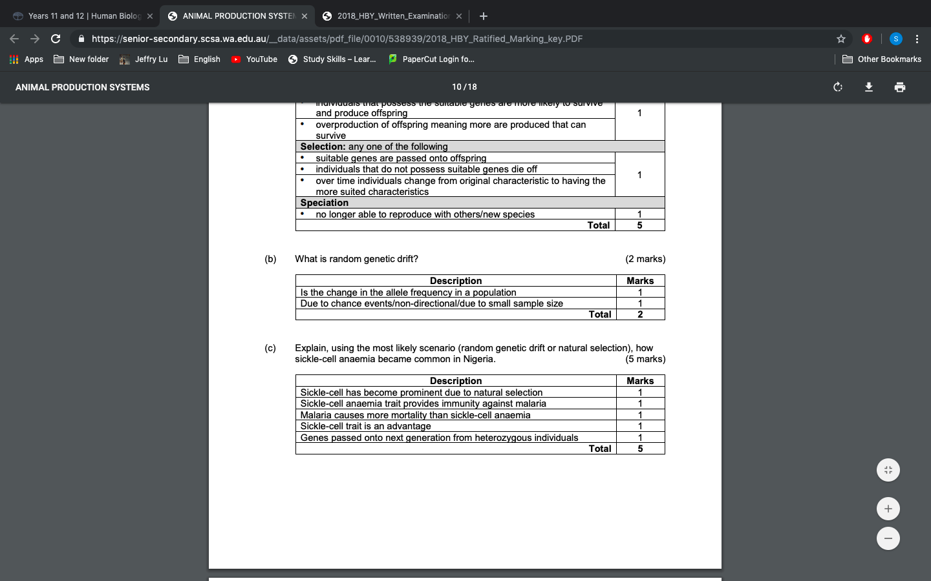
Genetic drift is another evolutionary mechanism that can cause a change in gene pools. What is random genetic drift?

Slide 26
Nigeria has the highest incidence of children born with sickle-cell anaemia, which can cause premature death. Explain, using the most likely scenario (random genetic drift or natural selection), how sickle-cell anaemia became common in Nigeria.

